Slide 1
Capstone Project
Presented By Group - eShield
Rajiv, Chintan & Hardik

Slide 2
Objective
eshield
Logistic Regression
Random Forest (concerned/not concerned)
Market Basket
Data Visualization
Support Vector Machine (SVM) (concerned/not concerned)

Slide 3
Random Forest

Slide 4
Objective
Response
Variable
Independant
Variable
Random Forest
To study behaviour of those who are prone to become a victim of fraud during online transaction
Response variable is taken as Money lost by responder ( victim of fraud)
There are 23 other predictors.
Few examples:age, education, profession, study, backup data, policy reading etc..

Slide 5
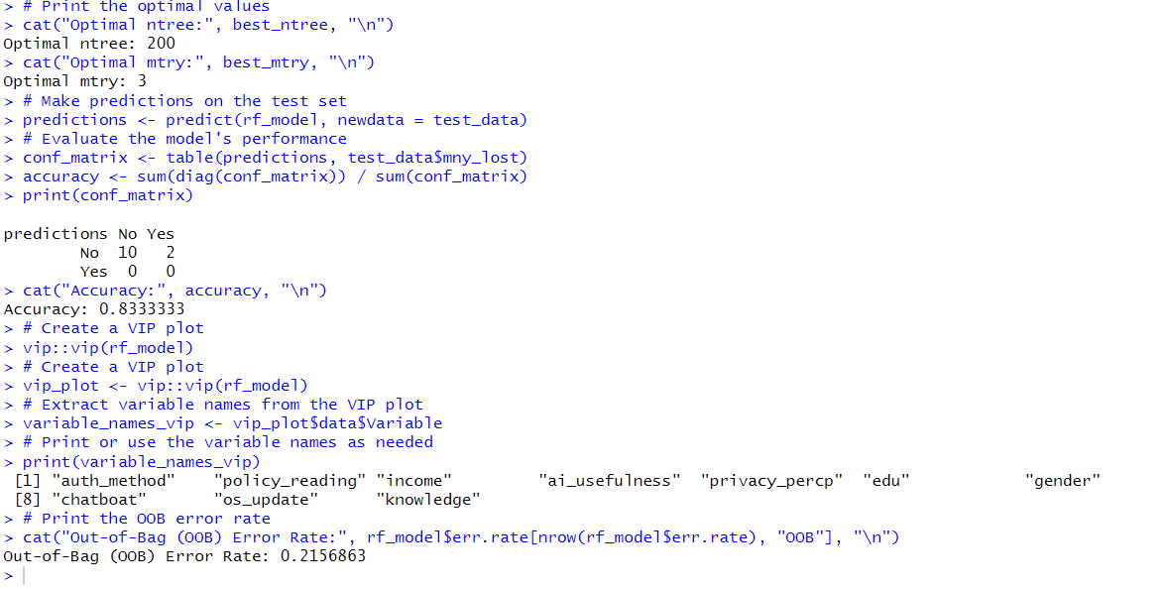
Coding
Random Forest

Slide 6
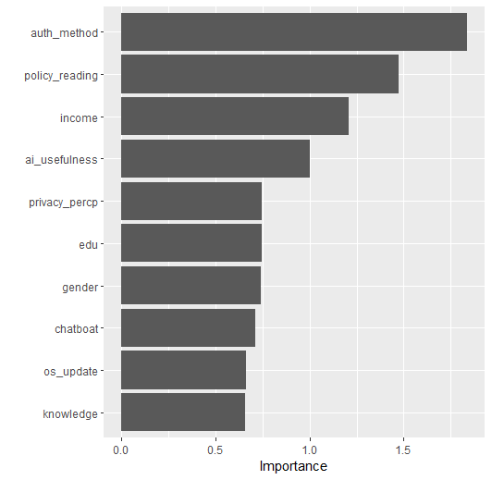
Output
Random Forest: Variable Importance Plot

Slide 7
Decision Tree

Slide 8
Objective
Response
Variable
Independant
Variable
Decision Tree
To identify classification of those who are concern to cyberbullying/fraud
Response variable is taken as Concern by responder
There are 23 other predictors.
Few examples:age, education, profession, study, backup data, policy reading etc..

Slide 9
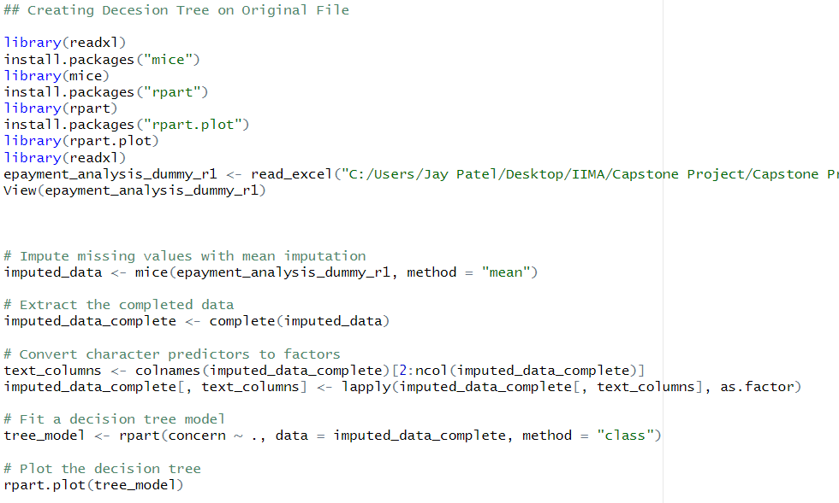
Coding
Decision Tree

Slide 10
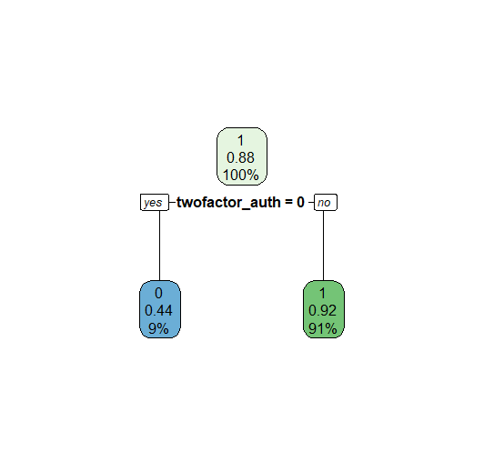
Output
Decision Tree

Slide 11
Data
Response Variable
Concerend , loose money,elearning platform, fraud
Predictor Variable
Variable Name | Variable Description
Response Variable
Status (Whether candidate would join or not

Slide 12
Method
Library and Data Load
converting response variable to numeric
Data split and removing null values from data
Defining variables and formulas
Fit Random Forest Model
Make predictions on the test set
Accuracy Check of the Model
Variable Importance

Slide 13
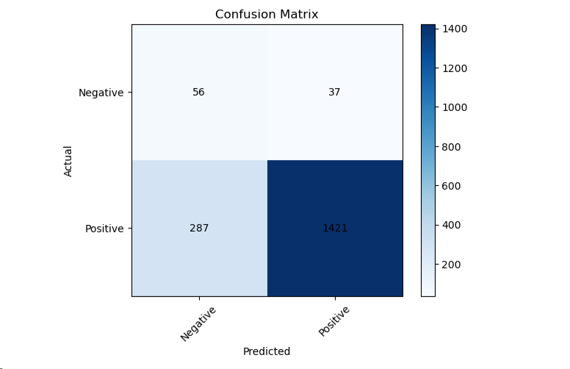
Confusion Matrix

Slide 14
Accuracy Measures
Metric | Value
True Positive (TP) | 1421
True Negative (TN) | 56
False Positive (FP) | 37
False Negative (FN) | 287
Accuracy | 0.817878
Out-of-Bag Accuracy | 0.826768
Precision | 0.97459
Recall (Sensitivity) | 0.831099
Specificity | 0.602151
F1-score | 0.897397

Slide 15
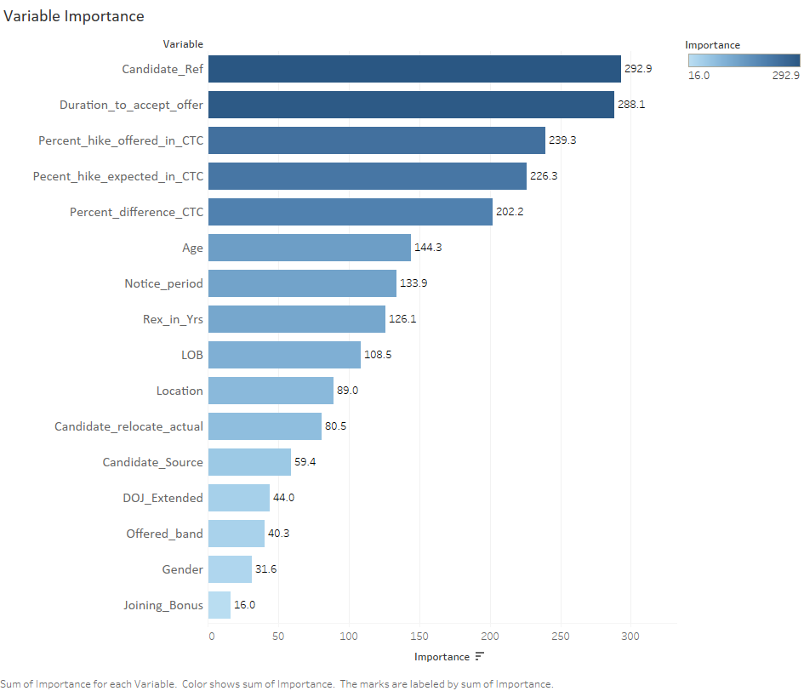
Variable Importance

Slide 16
Thank You

